Slide 1

Stabilizing Inverted Pendulum
University of Engineering and Technology Peshawar
Department of Computer System Engineering
Control System Project Presentation Muhammad Saad - 21pwcse1997

Slide 2

Introduction
Inverted Pendulum is a classic Control System challenge the stabilization of a pendulum in an inverted position.

Slide 3
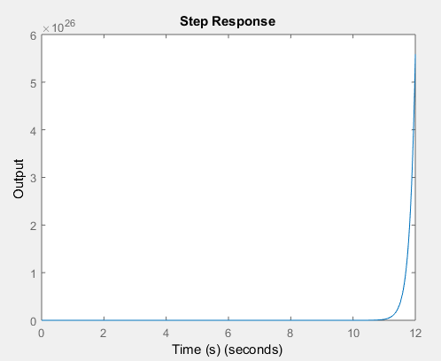
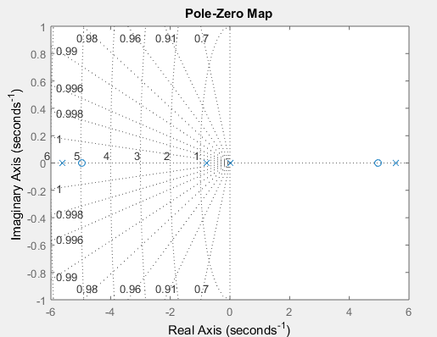
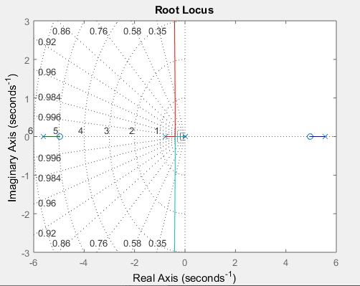
Stability Analysis
Initially the system is unstable. Here are following stability tests.

Slide 4
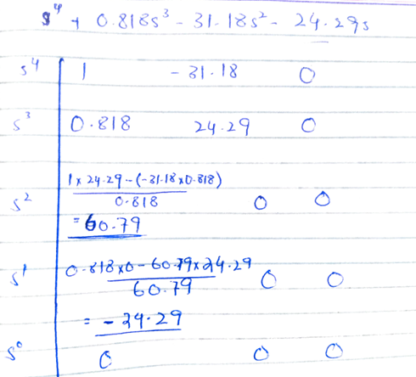
Stability Analysis (Cont.)
Following are the poles of the given system which suggests instability. 0 5.5670 -5.6067 -0.7783
By solving Routh Hurwitz table, the system was unstable as there sign changes.

Slide 5
Stabilizing The System
To stabilize the system, we will design the following controllers.
State-Feedback Controller Design
Observer Controller Design
Proportional, Integral, and Derivative

Slide 6
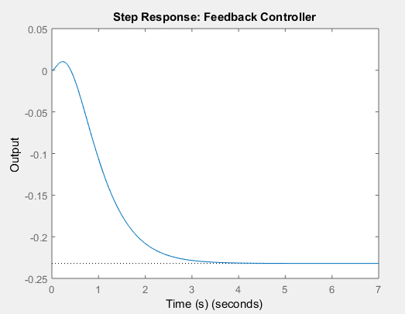
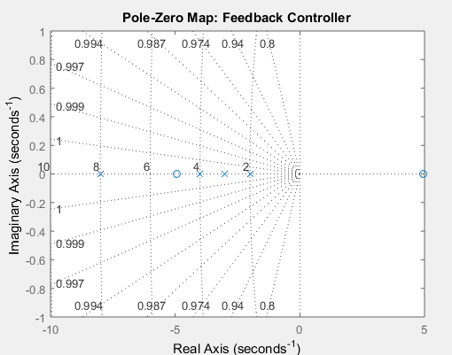
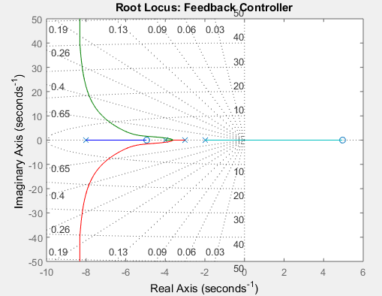
Stabilizing The System (Cont.)
State-Feedback Controller Design

Slide 7
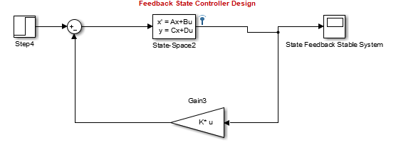
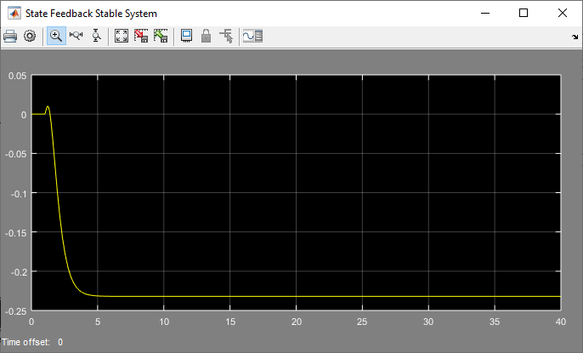
Stabilizing The System (Cont.)
State-Feedback Controller Design

Slide 8
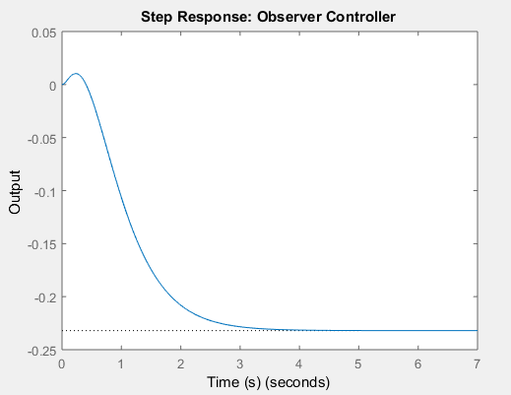
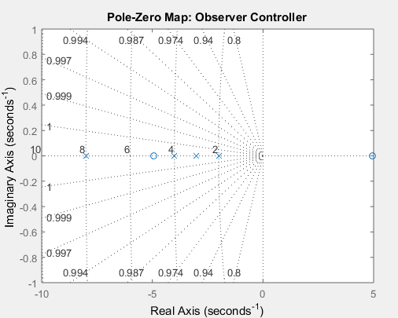
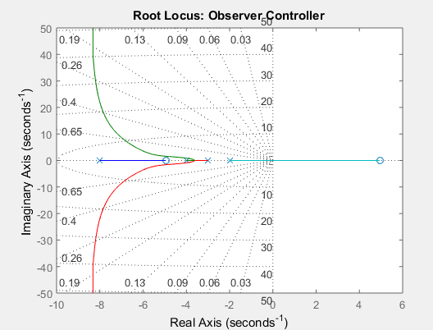
Stabilizing The System (Cont.)
Observer Controller Design

Slide 9
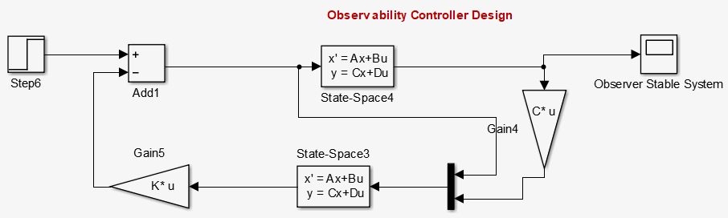
Stabilizing The System (Cont.)
Observer Controller Design

Slide 10
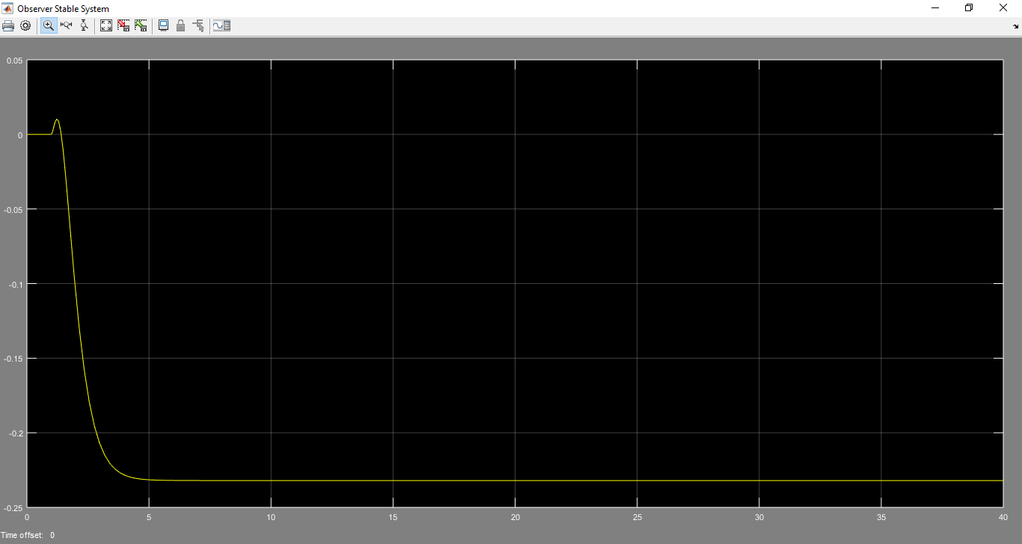
Stabilizing The System (Cont.)
Observer Controller Design

Slide 11
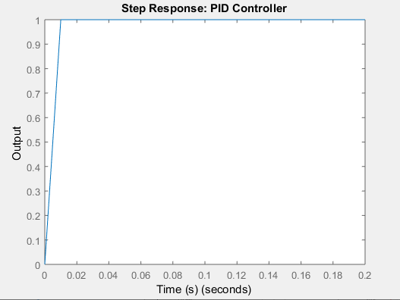
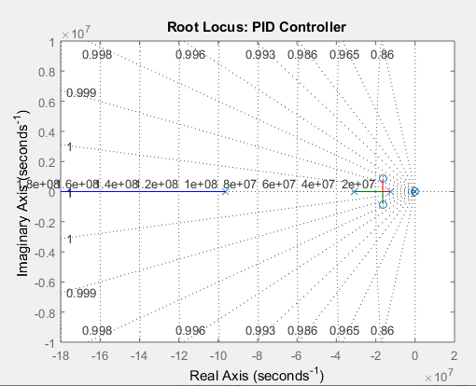
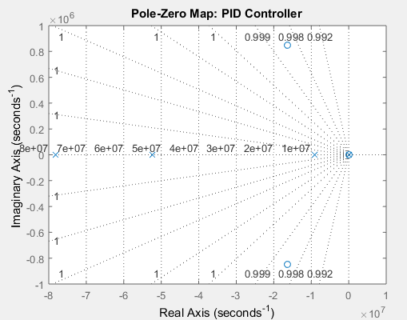
Stabilizing The System (Cont.)
PID Controller Design

Slide 12
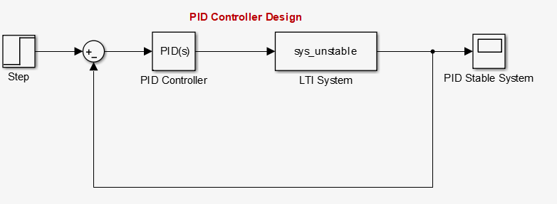
Stabilizing The System (Cont.)
PID Controller Design

Slide 13
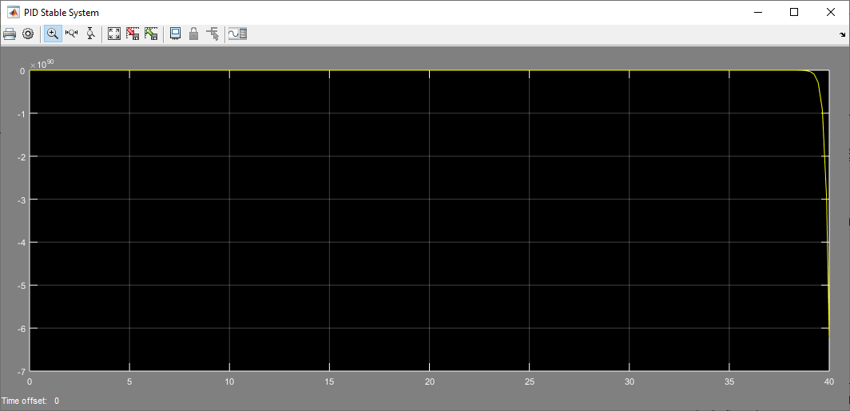
Stabilizing The System (Cont.)
PID Controller Design

Slide 14
Steady State Error Comparison
Desgin | Steady State Error
Un Stable System | -6.5871e+09
Feedback Controller | 1.2983
Observer Controller | 1.2983
PID Controller | 0.5000 | 5.1408e+12(pidtune)

Slide 15
Conclusion
With State-Feedback and Observer Controllers the system was stable but there was some steady state error (1.29). While the PID had less steady error but one pole was at 0+0i. So, it was marginally stable and the values for kp, ki and kd were higher than typical. Values suggested by pidtune() were giving an unstable system.

